Slide 1
Internship Presentation
Vruti Sivakumaran

Slide 2
Outline
Introduction
My Role
The Project
Background Information
The Solution
Final Product
What I Learned

Slide 3
Introduction
Carnegie Mellon University
Electrical and Computer Engineering
Rising Senior
Operations Department
Supervisor: Kevin Wigell

Slide 4
My Role
Help Kevin with MPulse
MPulse:
Computerized Maintenance Management System (CMMS)
Contains information about maintenance work done on windfarms.
Ensure that all the right information can be found

Slide 5
The Project - Background
7 Wind Farms, 5 Contractors
Maintenance done by Contractors
Reports provided when maintenance done
Numerous reports every week

Slide 6
The Project - Background
Each contractor provides reports in a different format.
No easy way to get information from reports into MPulse.
Needed a way to get all the necessary information from the different reports.

Slide 7
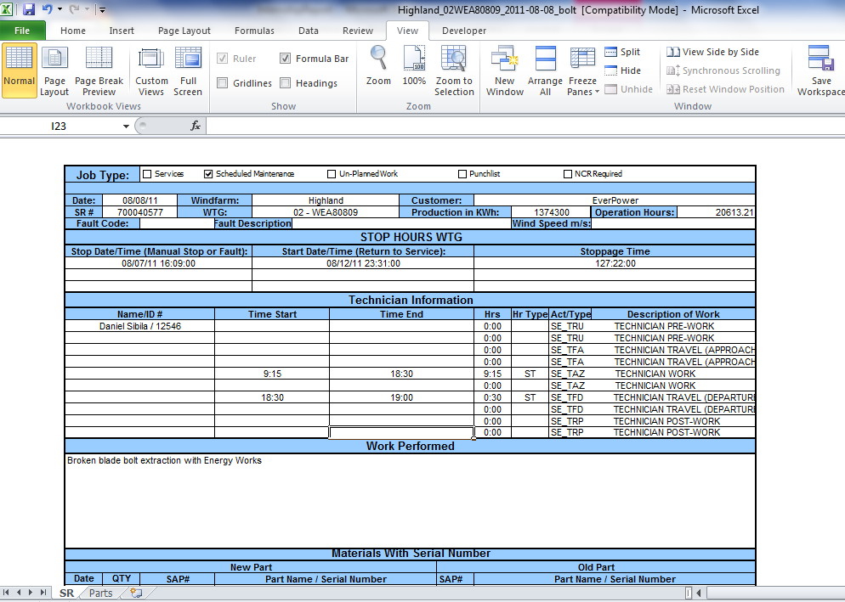
Report Example

Slide 8
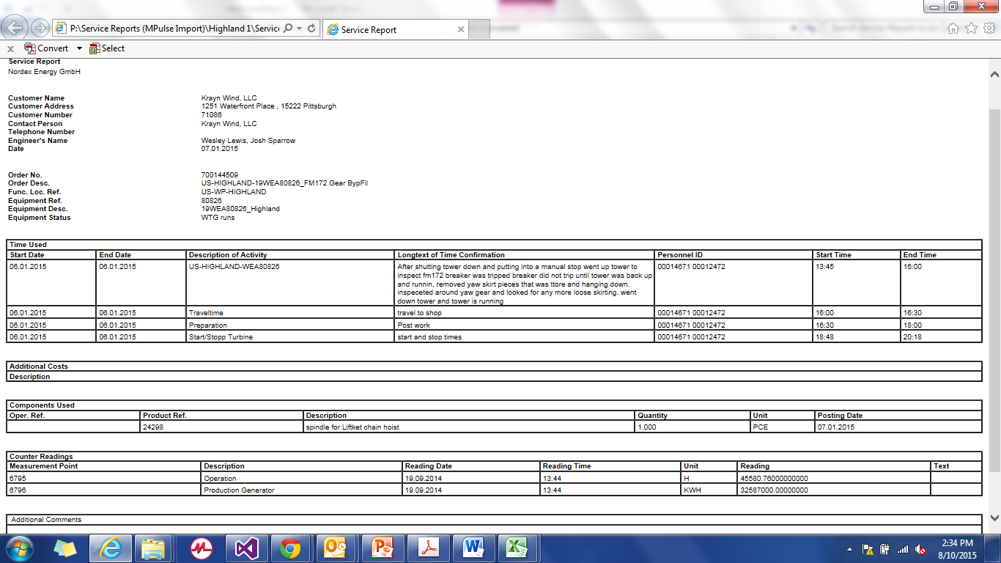
Report Example

Slide 9
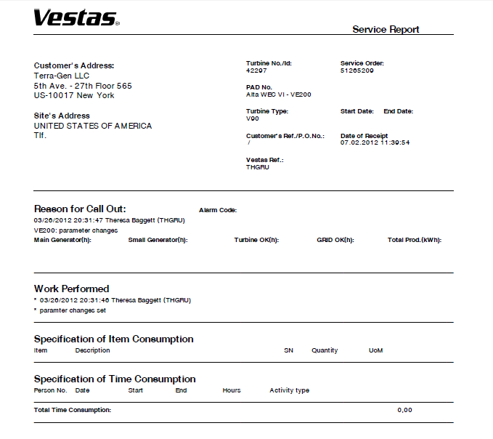
Report Example

Slide 10
The Project - Solution
A program that can:
Read information from all the different types of reports
Identify the necessary data
Ensure that this data is valid
Write the data into an Excel file so that it can be imported into MPulse

Slide 11
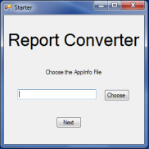
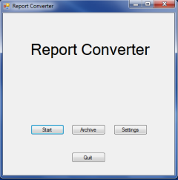
Final Product

Slide 12
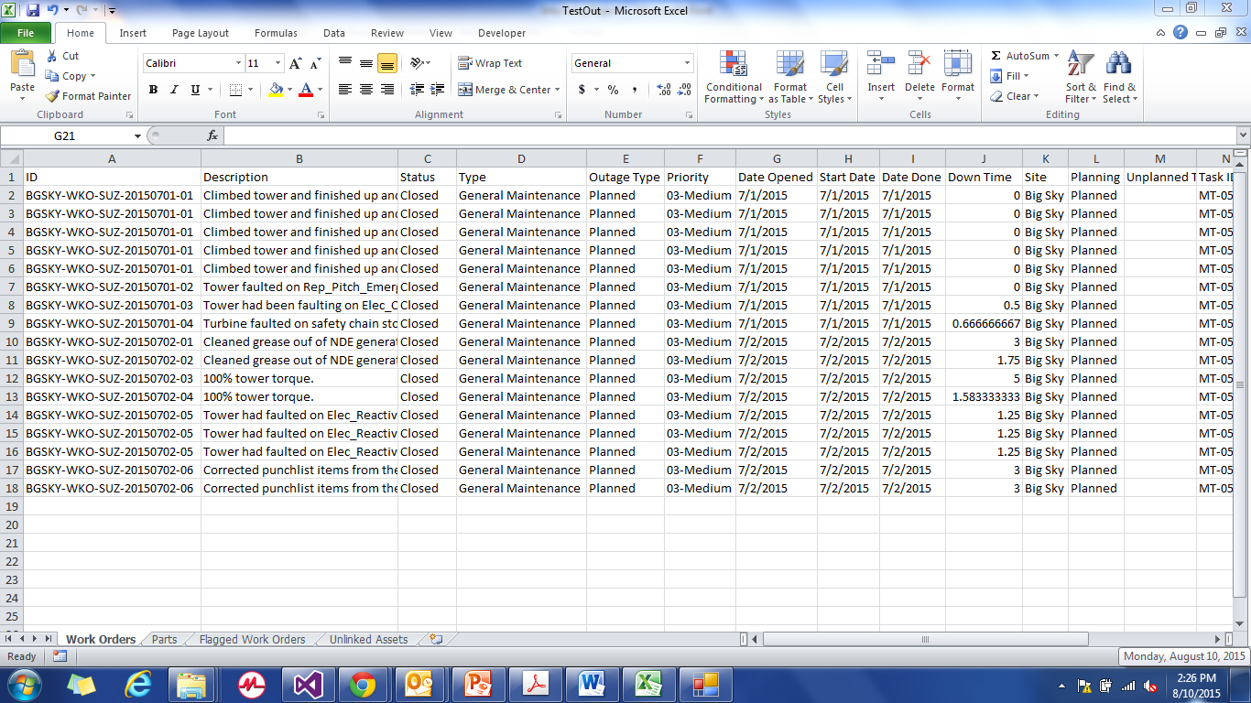
Final Product

Slide 13
What I learned

Slide 14
Questions?

Slide 15
Thank You!

